Slide 1
NeurIPS: Machine Unlearning
Project Proposal
CSE 472 Machine Learning Sessional
BY:
Syed Jarullah Hisham - 1805004
Abdur Rafi - 1805008

Slide 2
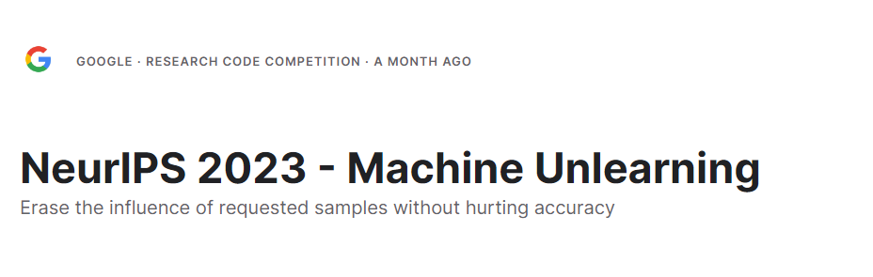
Competition Link: https://www.kaggle.com/competitions/neurips-2023-machine-unlearning/overview

Slide 3
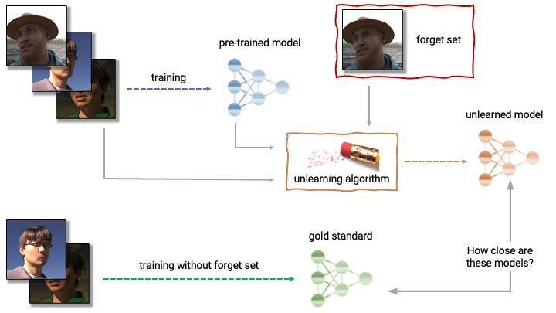
Problem Description

Slide 4
Motivation
Removing examples from a trained machine learning model is a major unsolved problem of ML privacy research
recent research has shown that it may be possible to infer with high accuracy whether an example was used to train a machine learning model using membership inference attacks (MIAs)
retraining whole model can be computationally expensive

Slide 5
Dataset & Code
Competition dataset is hidden
But this project can be tested on several datasets(e.g: CIFAR10, EMNIST etc)
Dataset Description https://www.kaggle.com/competitions/neurips-2023-machine-unlearning/data
Solution Code(For reproduction)
https://www.kaggle.com/code/fanchuan/2nd-place-machine-unlearning-solution?kernelSessionId=153137657

Slide 6
Solution Overview
3 Main approaches
Unsupervised learning(self supervised contrastive learning), then retrain
Add noise to weights, then retrain
Re-initialize some weights, then retrain

Slide 7
Experiment To Reproduce
1st place solution. 2 stage
Forget Stage
SimCLR (Self supervised contrastive learning) to push the distance between forget samples and retain samples
Retain Stage
Train on retain samples to finetune performance on retain samples

Slide 8
New Experiment
Calculate gradients on forget set and retain set
Subtract component of retain set gradient from forget set gradient
Use remaining component to climb up cost function

Slide 9
Thank You

